Slide 1
UNIT I
NUMBER THEORY

Slide 2
INTEGER ARITHMETIC
Set of Integers
Binary Operation
Integer Division
Divisibility

Slide 3

Set of Integers
The set of integers, denoted by Z, contains all integral numbers (with no fraction) from negative infinity to positive infinity
Figure 1 The set of integers

Slide 4
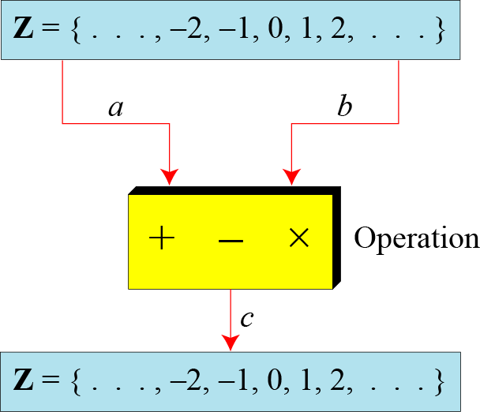
Binary Operations
In cryptography,
three binary operations are applied to the set of integers. A binary operation takes two inputs and creates one output.

Slide 5
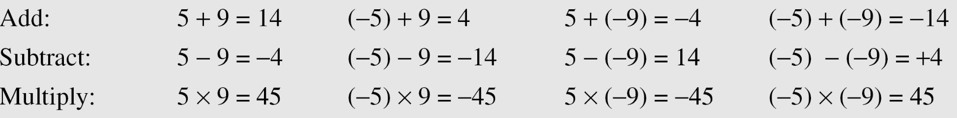
Continued
Example 1
The following shows the results of the three binary operations on two integers. Because each input can be either positive or negative, we can have four cases for each operation.

Slide 6
Integer Division
In integer arithmetic, if we divide a by n, we get q
and r . a /n
The relationship between these four integers can be shown as
a = q × n + r

Slide 7
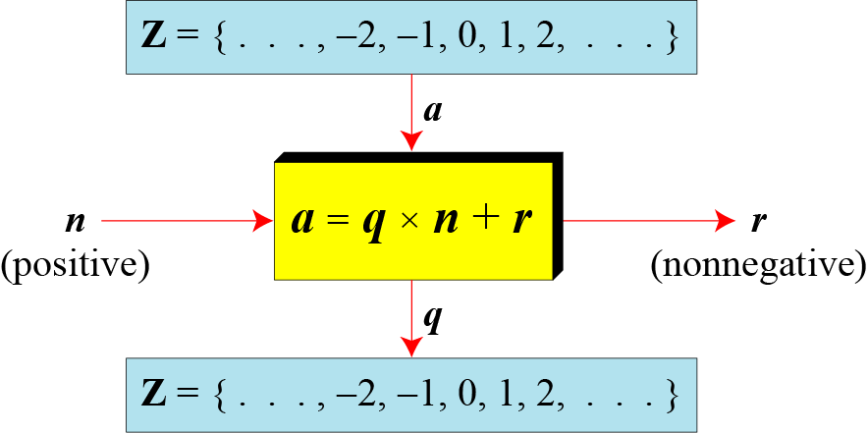
Continued
Figure 4 Division algorithm for integers

Slide 8
When we use a computer or a calculator, r and q are negative when a is negative.
How can we apply the restriction that r needs to be positive?
Continued
Example 3

Slide 9
When we use a computer or a calculator, r and q are negative when a is negative.
How can we apply the restriction that r needs to be positive?
Decrement the value of q by 1 and add the value of n to r to make it positive.
Continued
Example 3

Slide 10
When we use a computer or a calculator, r and q are negative when a is negative.
How can we apply the restriction that r needs to be positive?
Decrement the value of q by 1 and add the value of n to r to make it positive.
a = q × n + r
a = -255; n=11;
Continued
Example 3

Slide 11
When we use a computer or a calculator, r and q are negative when a is negative.
How can we apply the restriction that r needs to be positive?
Decrement the value of q by 1 and add the value of n to r to make it positive.
a = q × n + r
a = -255; n=11; q=-23 and r =-2.
Continued
Example 3

Slide 12
When we use a computer or a calculator, r and q are negative when a is negative.
How can we apply the restriction that r needs to be positive?
Decrement the value of q by 1 and add the value of n to r to make it positive.
a = q × n + r
a = -255; n=11; q=-23 and r =-2.
q=q-1 = -24;
r = n+r = 11-2 =9
-255 = (-24* 11) +9 = -264 + 9 = -255.
Continued
Example 3

Slide 13
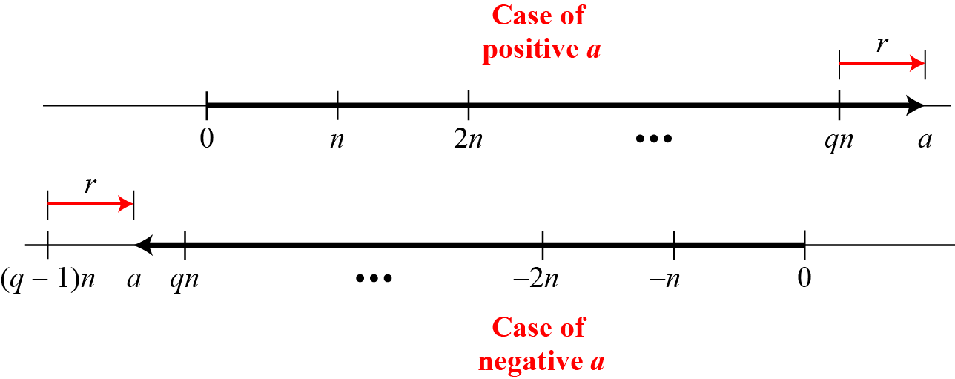
Continued
5.Graph of division alogorithm

Slide 14
Divisbility
If a is not zero and we let r = 0 in the division relation, we get
a = q × n
n divides a or n is a divisor of a or a is divisible by n
If the remainder is zero, n |a
If the remainder is not zero, then n | a

Slide 15
Continued
Example 4
The integer 4 divides the integer 32 because 32 = 8 × 4. We show this as
b. The number 8 does not divide the number 42 because
42 = 5 × 8 + 2. There is a remainder, the number 2, in the equation. We show this as

Slide 16
Continued
Properties
Property 1: if a|1, then a = ±1.
Property 2: if a|b and b|a, then a = ±b.
Property 3: if a|b and b|c, then a|c.
Property 4: if a|b and a|c, then a|(m × b + n × c), where m and n are arbitrary integers

Slide 17
a) Given 13, 78, 7, 98, -6,24,4,44, 11,-33
b) Given 13,27,7,50,-6,23,4,41,11,-32

Slide 18
Continued
Example 5

Slide 19
Given , find out the property satisfied
3,15,15,45
3,15,3,9

Slide 20
Continued
Example 6
.

Slide 21

Continued
Note
Fact 1: The integer 1 has only one divisor, itself.
Fact 2: Any positive integer has at least
two divisors, 1 and itself (but it can have more).

Slide 22
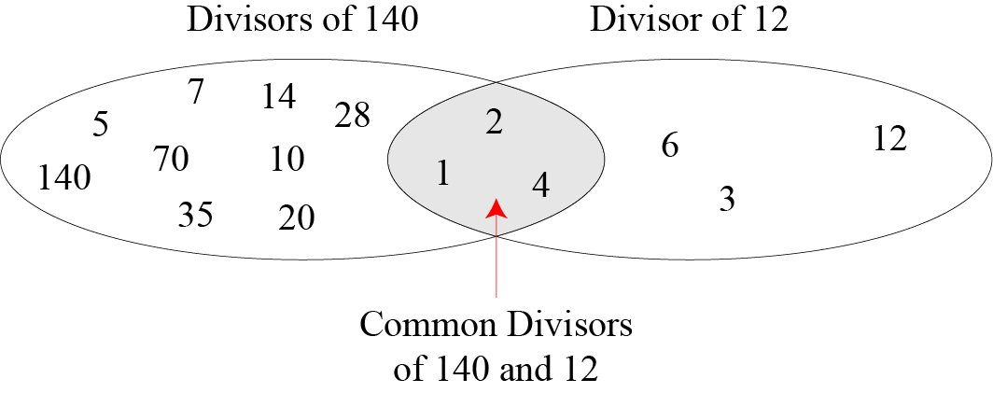
Contd…
Figure 6 Common divisors of two integers

Slide 23
Continued
Greatest Common Divisor
The greatest common divisor of two positive integers is the largest integer that can divide both integers.
gcd (140,12 )= ???

Slide 24
Euclidean Algorithm
Finding the gcd of 2 large integers – difficult
Euclid – alg-easy method – to find gcd

Slide 25
Euclidean Algorithm
Fact 1: gcd (a, 0) = a
second integer is 0, the gcd is the first one
Fact 2: gcd (a, b) = gcd (b, r)
where r is the remainder of dividing
a by b

Slide 26
Euclidean Algorithm
Calculate
(i) gcd(36,10)
(ii) gcd(140,12)

Slide 27
Euclidean Algorithm
Calculate
(i) gcd(36,10)
gcd(36,10)=gcd(10,6)=gcd(6,4)
=gcd(4,2)=gcd(2,0)=2

Slide 28
Euclidean Algorithm
gcd(140,12)
= gcd(12,8) = gcd(8,4)=gcd(4,0)=4
Fact 2 several times
Fact 1 once
When gcd (a, b) = 1, we say that a and b are relatively prime.

Slide 29
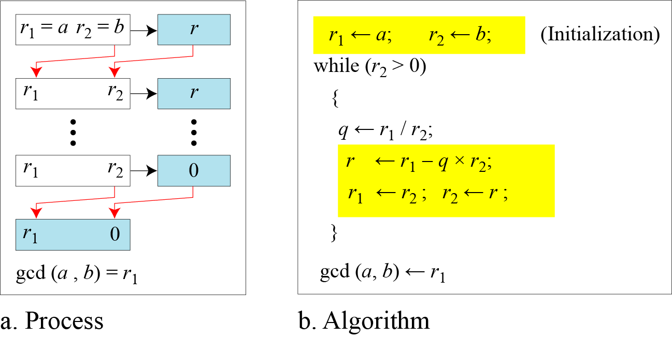
Continued
Figure 7 Euclidean Algorithm
r1,r2 – temp var ; a = 2740, b=1760
r –remainder of r1/r2

Slide 30
Euclidean Algorithm
Find gcd(2740,1760)
gcd(25,60)
q r1 r2 r

Slide 31
Euclidean Algorithm
Find gcd(2740,1760)
gcd(25,60)
q r1 r2 r
0 25 60 25
2 60 25 10
2 25 10 5
2 10 5 0
5 0

Slide 32
Extended Euclidean Algorithm
Given two integers a and b, we often need to find other two integers, s and t, such that
s×a + t×b =gcd(a,b)
The extended Euclidean algorithm can calculate the gcd (a, b) and at the same time calculate the value of s and t.
in addition to the greatest common divisor of integers a and b, also the coefficients of Bézout's identity, which are integers s and t
Given a =161, b =28, find gcd(a,b), s and t

Slide 33
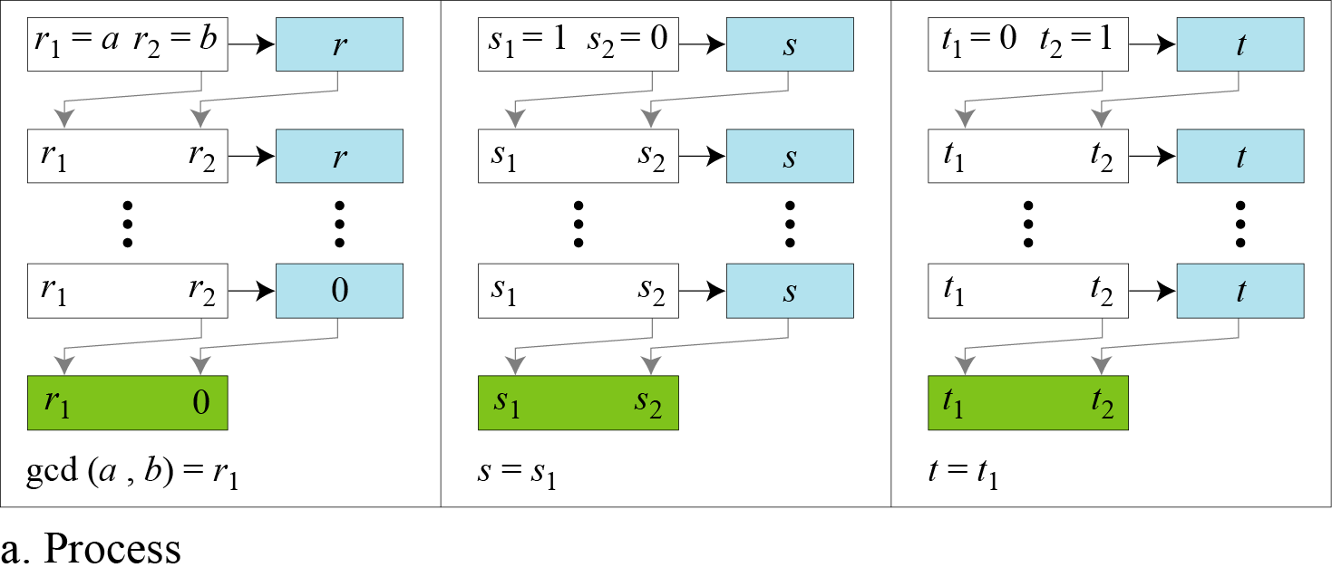
Continued
Figure 8.a Extended Euclidean algorithm, part a

Slide 34
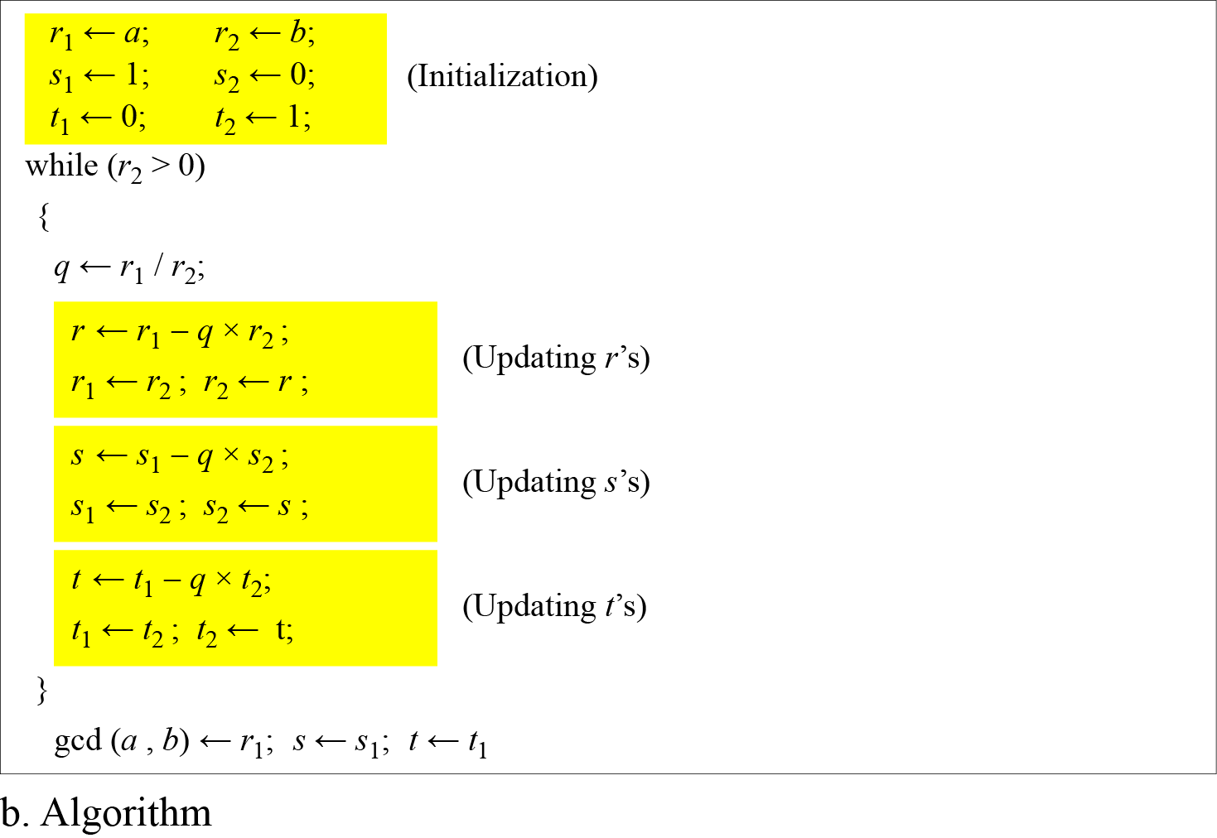
Continued
Figure 8.b Extended Euclidean algorithm, part b

Slide 35
MODULAR ARITHMETIC

Slide 36
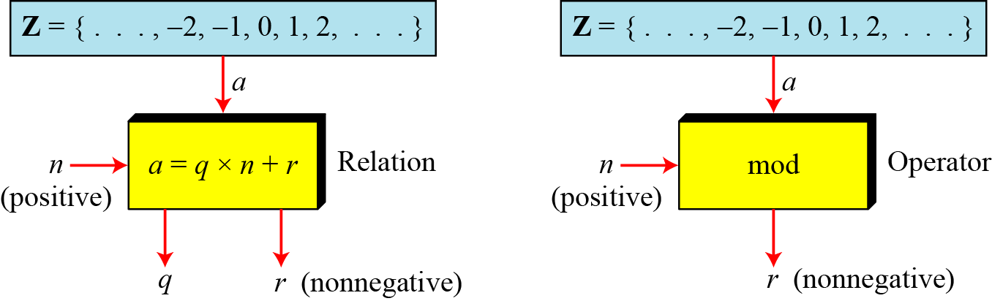
Modulo Operator
The modulo operator is shown as mod which returns the remainder.
The second input (n) is called the modulus.
The output r is called the residue.
Figure 9 Division algorithm and modulo operator

Slide 37
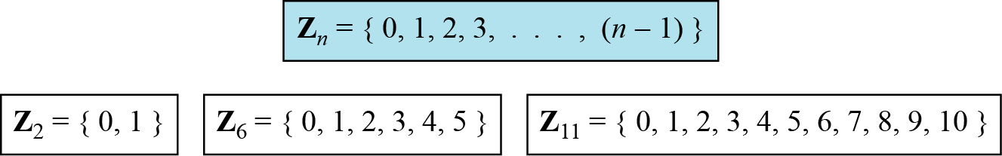
Set of Residues
The modulo operation creates a set, which in modular arithmetic is referred to as the set of least residues modulo n, or Z_{n}.
Figure 10 Some Z_{n} sets

Slide 38
Congruence
Congruence instead of equality
Mapping from Z to Zn is not one to one
For example,
2 mod 10 =2, 12 mod 10 =2, 22 mod 10 =2 and so on
In Modular arithmetic,
Integers like 2,12, and 22 are called
congruent mod 10
To show that two integers are congruent, we use the congruence operator ( ≡ ).

Slide 39
Congruence
Congruence looks like equality but not so
Equality maps a member of Z to itself but
Congruence maps a member from Z to Zn
Equality is one to one
Congruence is many to one
To show that two integers are congruent, we use the congruence operator ( ≡ ).
For example, we write:

Slide 40
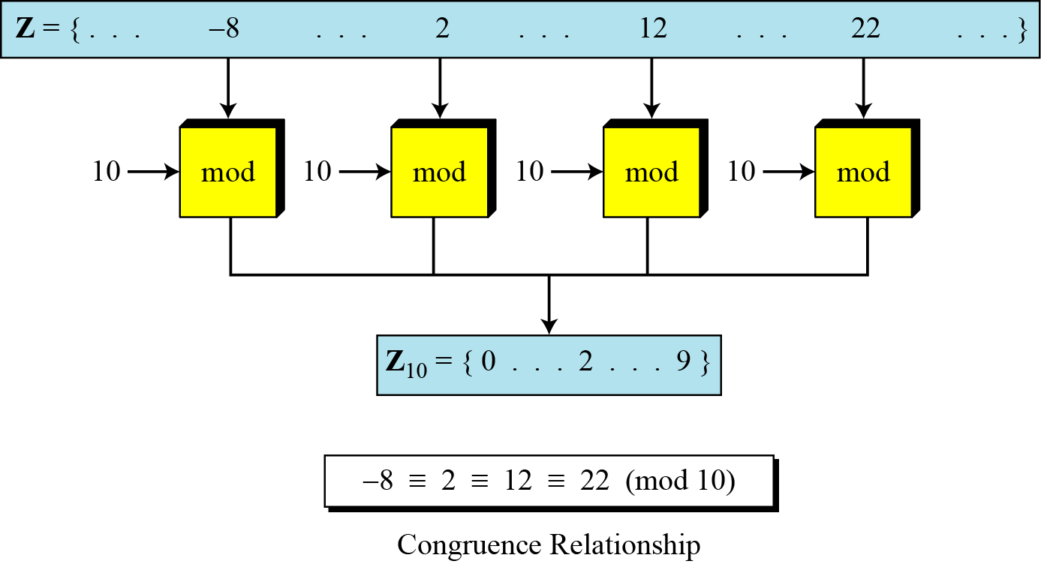
Continued
Figure 11 Concept of congruence

Slide 41
Residue Classes
A residue class [a] or [a]_{n} is the set of integers congruent modulo n.
Set of all integers s.t. x=a(mod n)
Eg. n-=5;

Slide 42
Residue Classes
A residue class [a] or [a]_{n} is the set of integers congruent modulo n.
Set of all integers s.t. x=a(mod n)
Eg. n-=5;
FIVE sets [0],[1],[2],[3],[4]

Slide 43
Residue Classes
Eg. n=5; FIVE sets [0],[1],[2],[3],[4]
[0] = {…, -15, -10, -5,0,5,10,15,…}
[1] = {…,-14, -9, -4,1,6,11,16,…}
[2] = {…, -13, -8, -3, 2, 7, 12,17,…}
[3] = {…,12, -7, -5, 3,8, 13,18,…}
[4] = {…, -11, -6, -1, 4, 9, 14, 19,…}
In each set, there is one element called
least(nonnegative) residue

Slide 44
Residue Classes
Eg. n=5; FIVE sets [0],[1],[2],[3],[4]
[0] = {…, -15, -10, -5,0,5,10,15,…}
[1] = {…,-14, -9, -4,1,6,11,16,…}
[2] = {…, -13, -8, -3, 2, 7, 12,17,…}
[3] = {…,12, -7, -5, 3,8, 13,18,…}
[4] = {…, -11, -6, -1, 4, 9, 14, 19,…}
In each set, there is one element called
least(nonnegative) residue
Z_{n} is the set of all least residue modulo n
Z₅ = { 0,1,2,3,4}

Slide 45
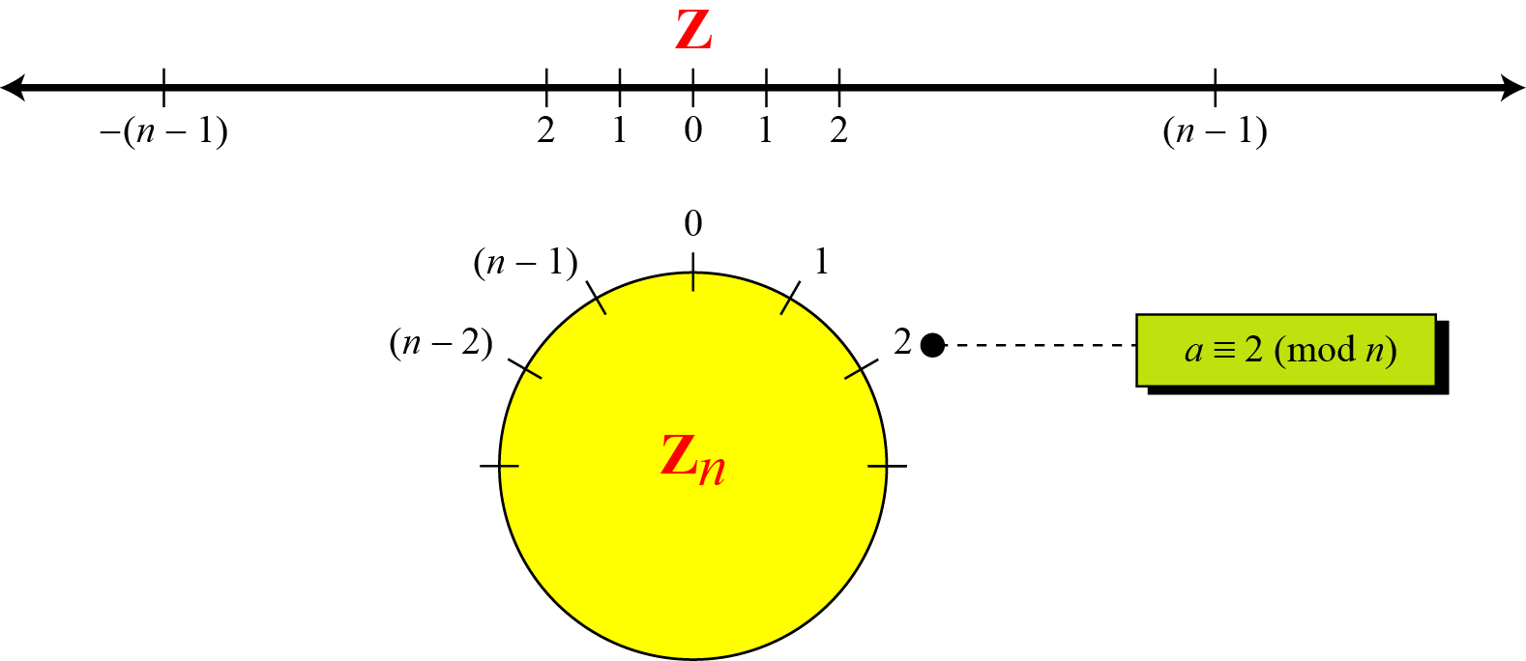
Continued
Figure 12 Comparison of Z and Z_{n} using graphs

Slide 46
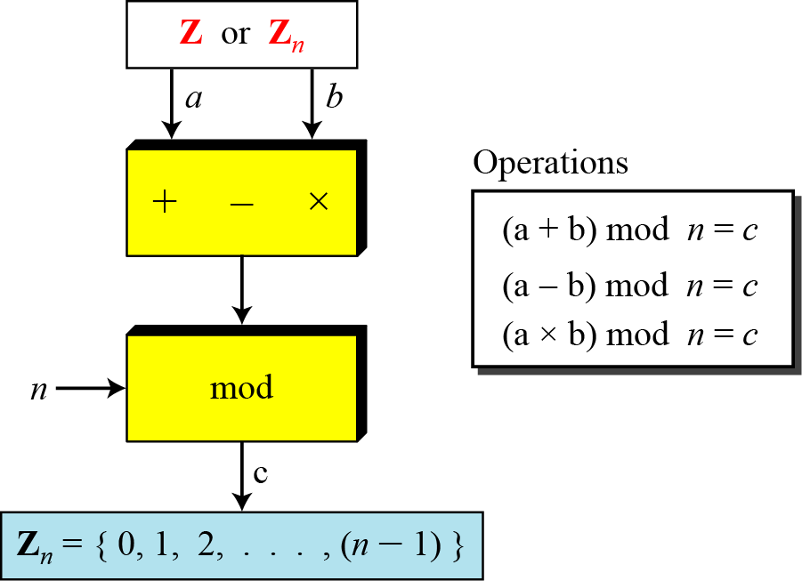
Operations in Z_{n}
The three binary operations for the set Z can also be defined for the set Zn.
The result may need to be mapped to Zn using the mod operator.
Figure 13 Binary operations in Z_{n}

Slide 47
Continued
Properties
First property : (a+b) mod n = [(a mod n) + (b mod n)] mod n
Second Property : (a-b) mod n = [(a mod n) - (b mod n)] mod n
Third property : (aXb) mod n = [(a mod n X (b mod n)] mod n

Slide 48
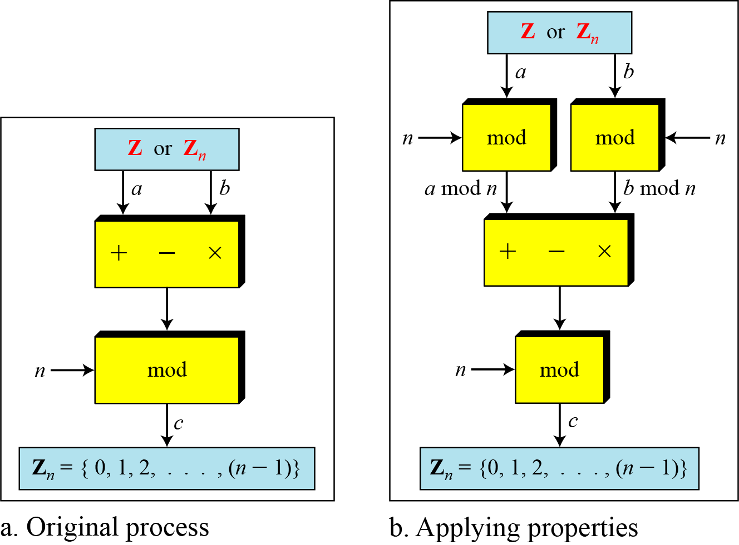
Continued
Figure 14 Properties of mod operator

Slide 49
Modular Operator
Find the result of the following operations:
27 mod 5
b . 36 mod 12
−18 mod 14
d. −7 mod 10
Notes:
Substitution ciphers form the first of the fundamental building blocks. The core idea is to replace one basic unit (letter/byte) with another. Whilst the early Greeks described several substitution ciphers, the first attested use in military affairs of one was by Julius Caesar, described by him in Gallic Wars (cf. Kahn pp83-84). Still call any cipher using a simple letter shift a caesar cipher, not just those with shift 3.

Slide 50
Modular Operator
Find the result of the following operations:
27 mod 5
Dividing 27 by 5 results in r = 2
b .36 mod 12
Dividing 36 by 12 results in r = 0.
−18 mod 14
Dividing −18 by 14 results in r = −4. After adding the modulus r = 10
d. −7 mod 10
Dividing −7 by 10 results in r = −7. After adding the modulus to −7, r = 3.
Notes:
Substitution ciphers form the first of the fundamental building blocks. The core idea is to replace one basic unit (letter/byte) with another. Whilst the early Greeks described several substitution ciphers, the first attested use in military affairs of one was by Julius Caesar, described by him in Gallic Wars (cf. Kahn pp83-84). Still call any cipher using a simple letter shift a caesar cipher, not just those with shift 3.

Slide 51
Additive Inverse
In Z_{n}, two numbers a and b are additive inverses of each other iff
(a + b) ≡ 0 (mod n)
In modular arithmetic, each integer has an additive inverse. The sum of an integer and its additive inverse is congruent to 0 modulo n.

Slide 52
Additive Inverse
(i) Find all additive inverse pairs in Z₁₀
(ii) Find the additive inverse of -2 in Z₁₀
(iii) Find the additive inverse of -2 in Z₂₆

Slide 53
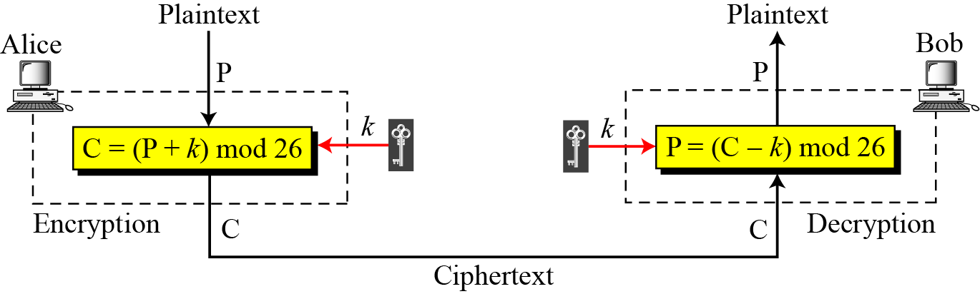
Additive cipher
When the cipher is additive, the plaintext, ciphertext, and key are integers in Z₂₆.

Slide 54
Additive cipher
Use the additive cipher with key = 15 to encrypt the message “hello”.
Solution
We apply the encryption algorithm to the plaintext, character by character:

Slide 55
Additive cipher
Use the additive cipher with key = 15 to encrypt the message “hello”.
Solution
We apply the encryption algorithm to the plaintext, character by character:

Slide 56
Additive cipher
Use the additive cipher with key = 15 to decrypt the message “WTAAD”.
Solution
We apply the decryption algorithm to the plaintext character by character:
a+ b ≡ 0 (mod n)
Additive inverse of a is calculated as b=n-a

Slide 57
Multiplicative Inverse
In Z_{n}, two numbers a and b are the multiplicative inverse of each other iff
a x b ≡ 1 (mod n)
In modular arithmetic, an integer may or may not have a multiplicative inverse.
When it does, the product of the integer and its multiplicative inverse is congruent to 1 modulo n.

Slide 58
Multiplicative Inverse
a * b ≡ 1 (mod n)
Z_{n} cannot be the set of possible keys because
Only some members of the set have multiplicative inverse
A subset of Z₂₆ with integers in Z₂₆ that have an unique set Z*₂₆

Slide 59
Multiplicative Inverse
Find out the keys in Multiplicative cipher for
Z ₆
Z ₇
Z ₁₀

Slide 60
Multiplicative Ciphers
What is the key domain for any multiplicative cipher?
Solution
The key needs to be in Z₂₆*.

Slide 61
Multiplicative Ciphers
What is the key domain for any multiplicative cipher?
Solution
The key needs to be in Z₂₆*.
This set has only 12 members: 1, 3, 5, 7, 9, 11, 15, 17, 19, 21, 23, 25.

Slide 62
Multiplicative Ciphers
What is the key domain for any multiplicative cipher?
Solution
The key needs to be in Z₂₆*. This set has only 12 members: 1, 3, 5, 7, 9, 11, 15, 17, 19, 21, 23, 25.
We use a multiplicative cipher to encrypt the message “hello” with a key of 7.

Slide 63
Multiplicative Ciphers
What is the key domain for any multiplicative cipher?
Solution
The key needs to be in Z₂₆*. This set has only 12 members: 1, 3, 5, 7, 9, 11, 15, 17, 19, 21, 23, 25.
We use a multiplicative cipher to encrypt the message “hello” with a key of 7. The ciphertext is “XCZZU”.

Slide 64
Continued
The multiplicative inverses of b in Z_{n} when n and b are given
gcd (n, b) = 1.

Slide 65
Continued
The extended Euclidean algorithm finds the multiplicative inverses of b in Z_{n} when n and b are given and
gcd (n, b) = 1.
The multiplicative inverse of b is the value of t after being mapped to Z_{n}.

Slide 66
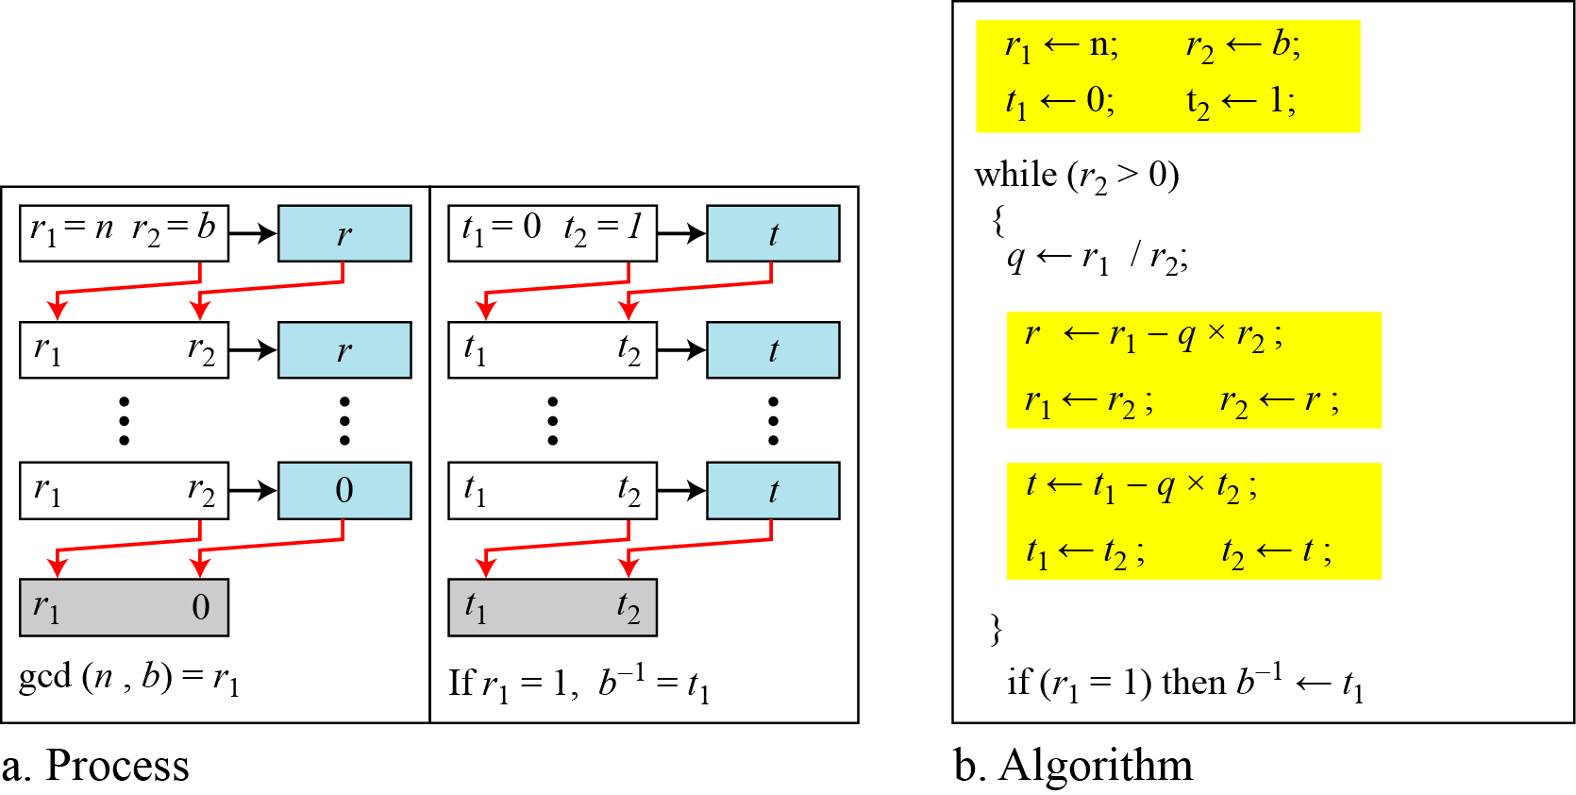
Continued
Figure 15 Using extended Euclidean algorithm to find multiplicative inverse

Slide 67
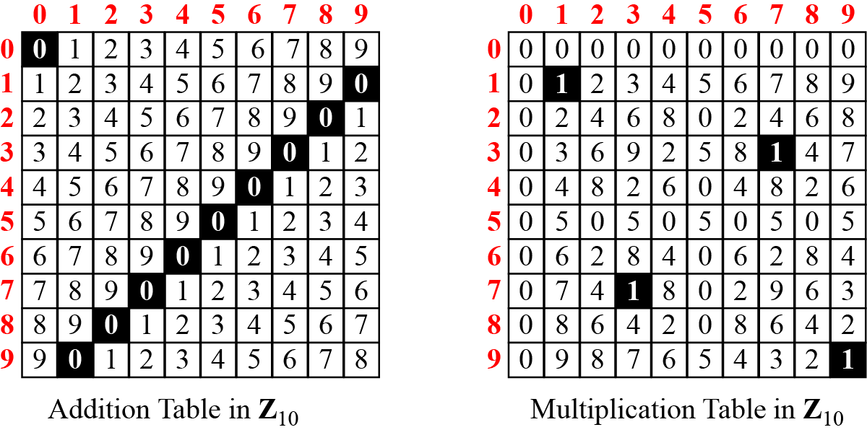
Addition and Multiplication Tables
Figure 2.16 Addition and multiplication table for Z₁₀

Slide 68
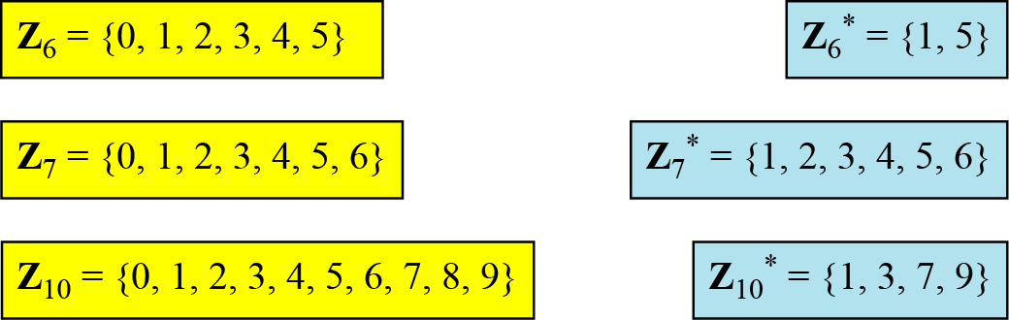
Different Sets
Figure 17 Some Z_{n} and Z_{n}* sets
We need to use Zn when additive inverses are needed; we need to use Zn* when multiplicative inverses are needed.

Slide 69
Two More Sets
Cryptography often uses two more sets: Z_{p} and Z_{p}*. The modulus in these two sets is a prime number.

